Slide 1
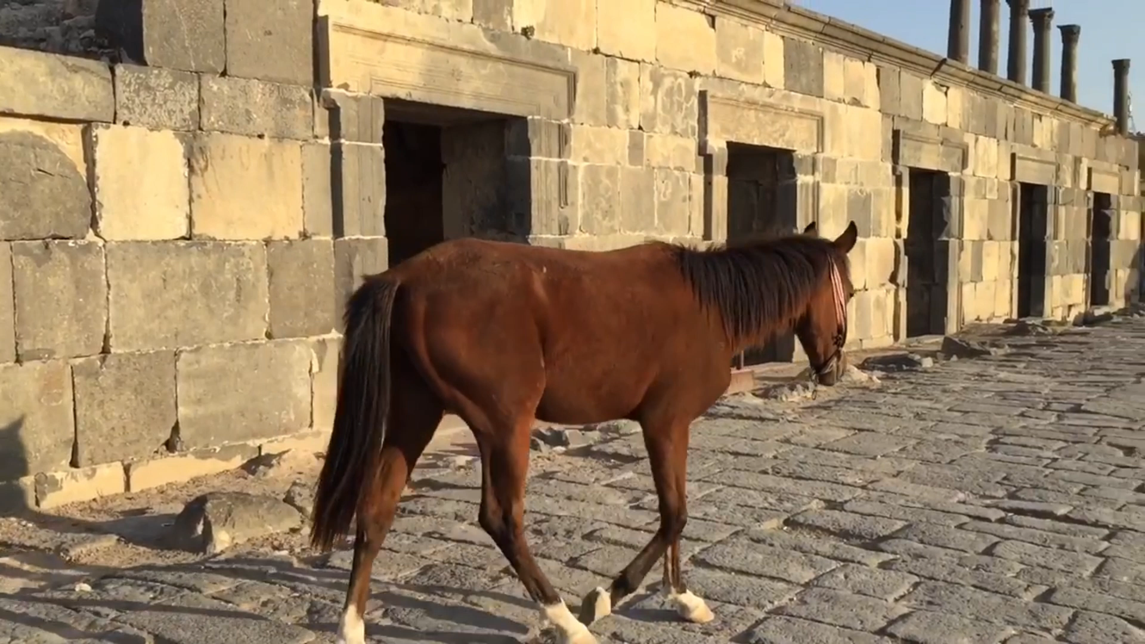
Image Classification for Archaeological Sites

Slide 2
Table of Contents
01: Problem
02: Solution
03: Technology Stack
05: Backbone and The Learning Curve
06: Classification State
04: Model Pipeline
07: Business Features and The Product Show
09: Resources
08: Future work

Slide 3

Problem & Solution

Slide 4
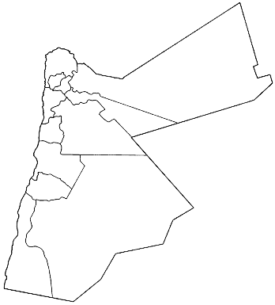

Slide 5
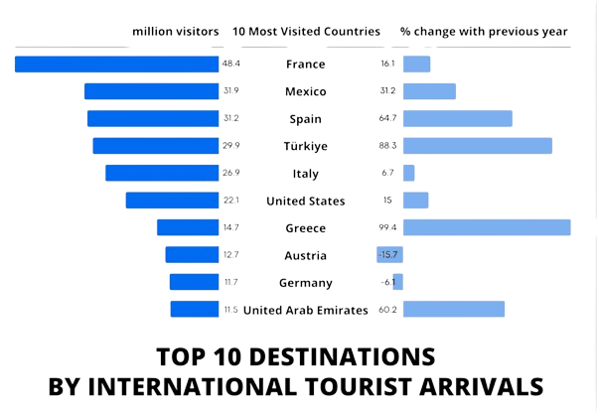

Slide 6

Solution
In this project, we aim to develop a deep learning model for automated image classification of archaeological sites.

Slide 7
03
Technology Stack

Slide 8

Data Collection
Class | Number
Ajloun Castle | 648
Jerash Theater | 618
Jerash Pillars | 621
Petra | 633
Roman amphitheater | 644
Umm Qais | 550
Wadi Rum | 510
Train = 3,794
Test = 430
Total = 4,224

Slide 9
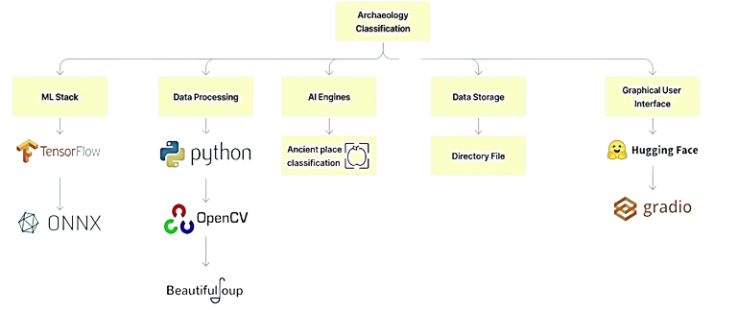
Technology Stack

Slide 10
04
Model Pipeline

Slide 11
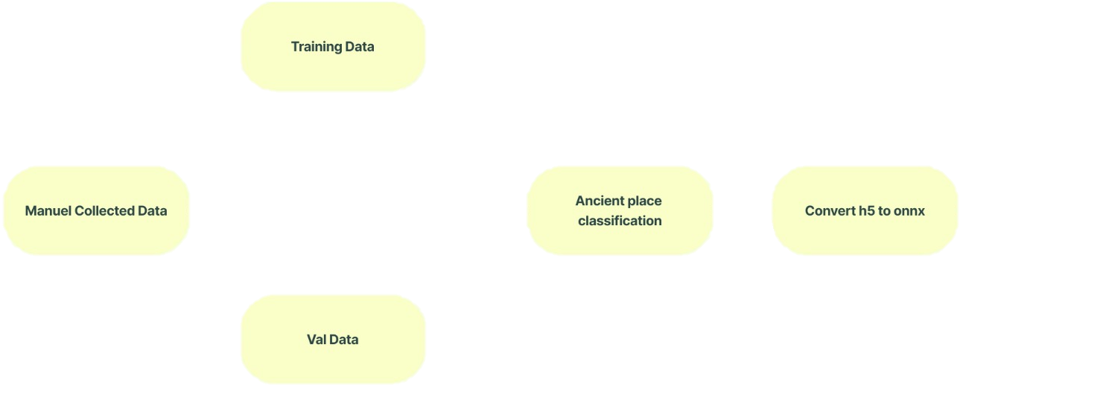
Model Pipeline (1)

Slide 12
Classification States
Classification State
Classification MUX
Prediction | Value
0 | Ajloun Castle
1 | Jerash Theater
2 | Jerash Pillars
3 | Petra
4 | Roman amphitheater
5 | Umm Qais
6 | Wadi Rum

Slide 13
05
Backbone and The Learning curve

Slide 14
Modelling
Backbone | Advantages | Disadvantages
VGG19 | Simplicity and Uniformity. Good Generalization. Transfer Learning. | Computational Intensity. Large Number of Parameters. Memory Requirements.
ResNet50 | Deep Residual Learning. High Accuracy. Ease of Training. | Increased Model Complexity. Resource Intensive. Sensitivity to Hyperparameters.
EfficientNet | Efficient Architecture. Compound scaling. State-of-The-Art Performance. | Limited Interoperability. Training Complexity. May Not Be Suitable for All Tasks.
InceptionV3 | Multi-Scale Processing. Efficient Use of Parameters. Good Balance between Accuracy and Computational Cost. | complex Architecture. Potential Overfitting. Resource Intensive.

Slide 15
Results
 | Accuracy | Precision | Recall | F1 Score
VGG19 | 0.8868 | 0.8917 | 0.8860 | 0.8839
InceptionV3 | 0.76 | 0.80 | 0.76 | 0.77
ResNet50 | 0.5721 | 0.6531 | 0.5721 | 0.5905
EfficientNet | 0.1349 | 0.0240 | 0.1349 | 0.0374

Slide 16
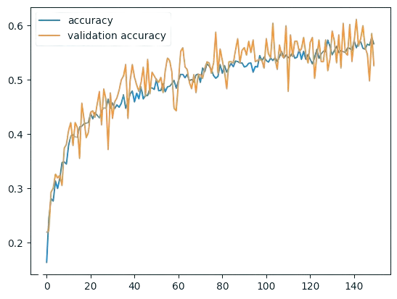
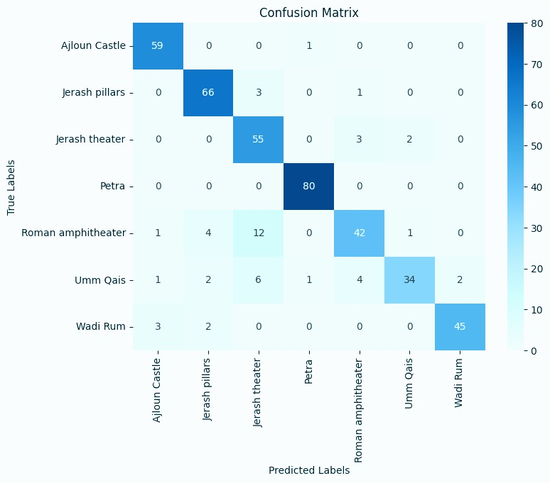
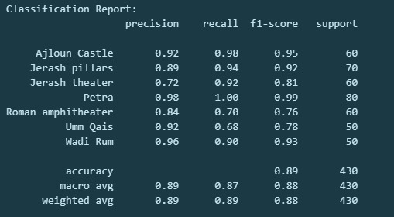
VGG19

Slide 17
VGG19

Slide 18
VGG19

Slide 19
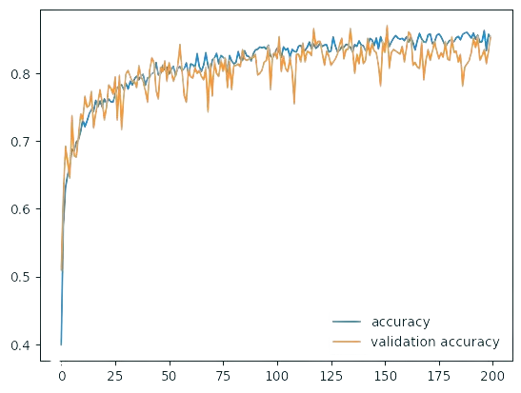
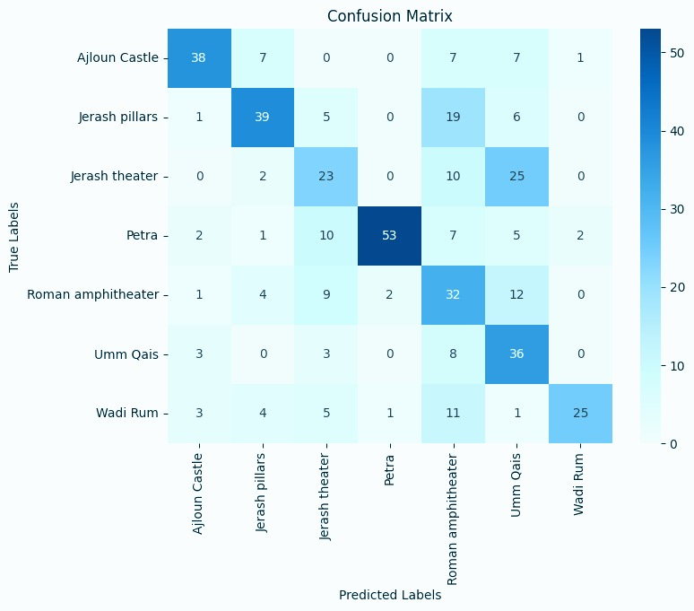
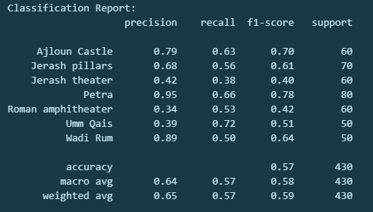
ResNet50

Slide 20
ResNet50

Slide 21
ResNet50

Slide 22
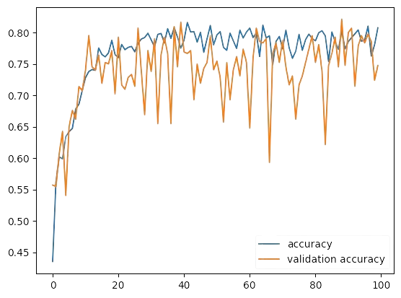
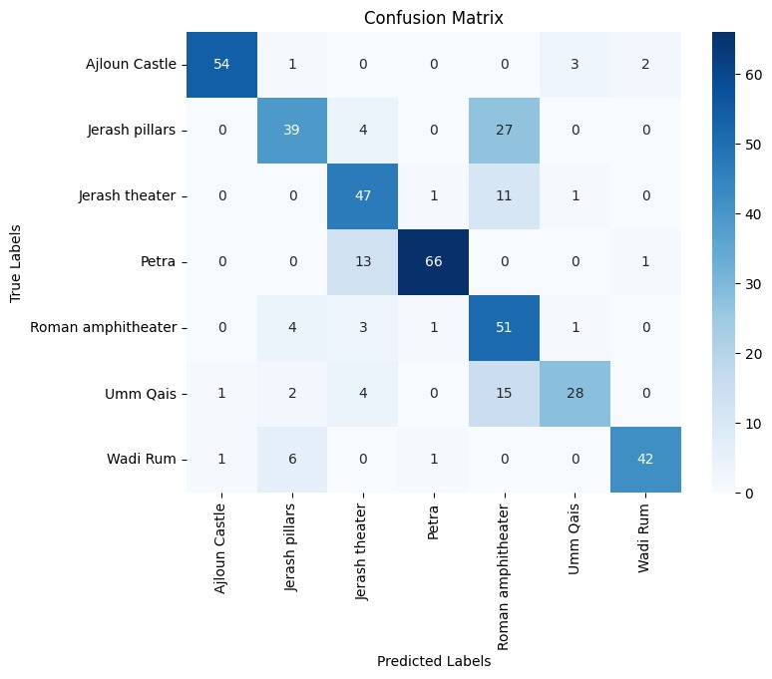
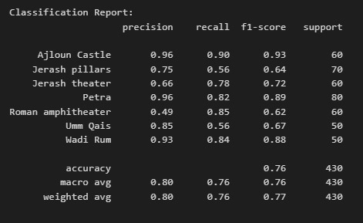
InceptionV3

Slide 23
InceptionV3

Slide 24
InceptionV3

Slide 25
07
Business Fractures and The Product Show

Slide 26
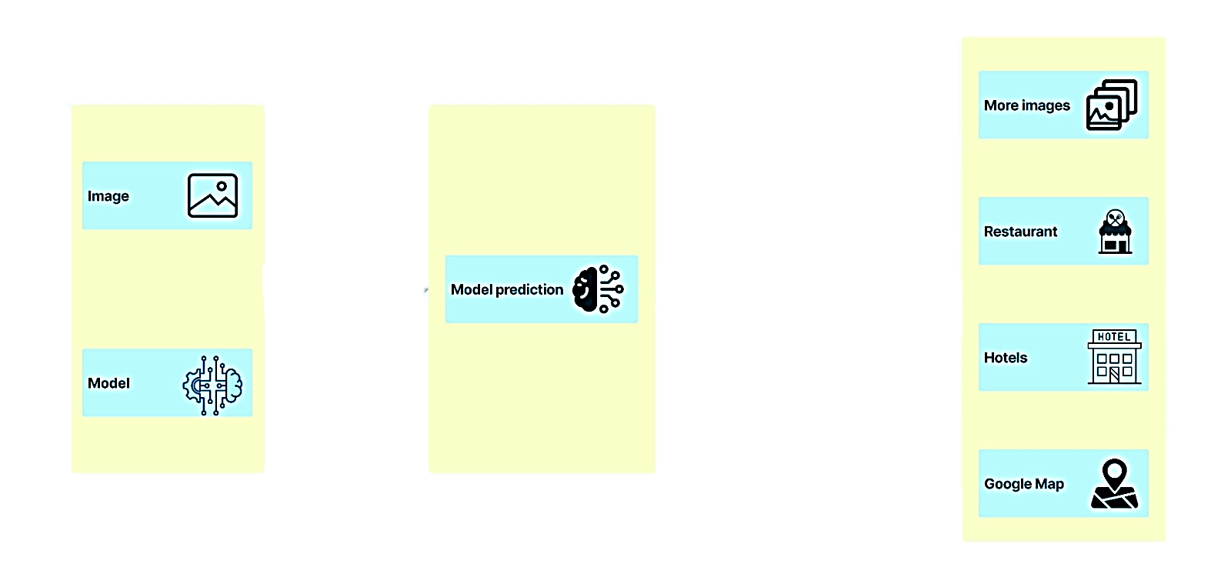
Business Features
Business features

Slide 27
08
Future Work

Slide 28
Future work
Model Optimization.
User Feedback Integration.
Add more places.

Slide 29
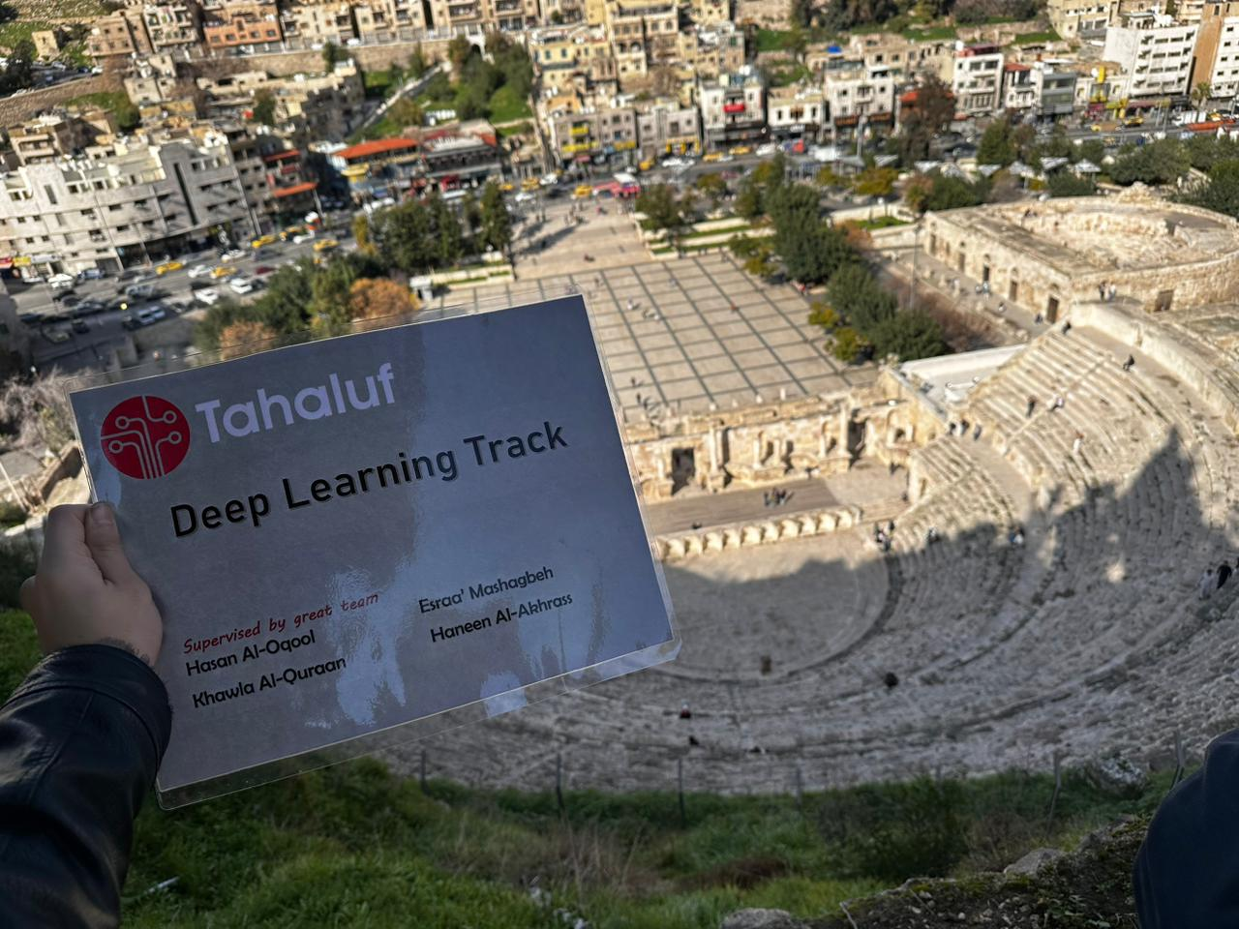
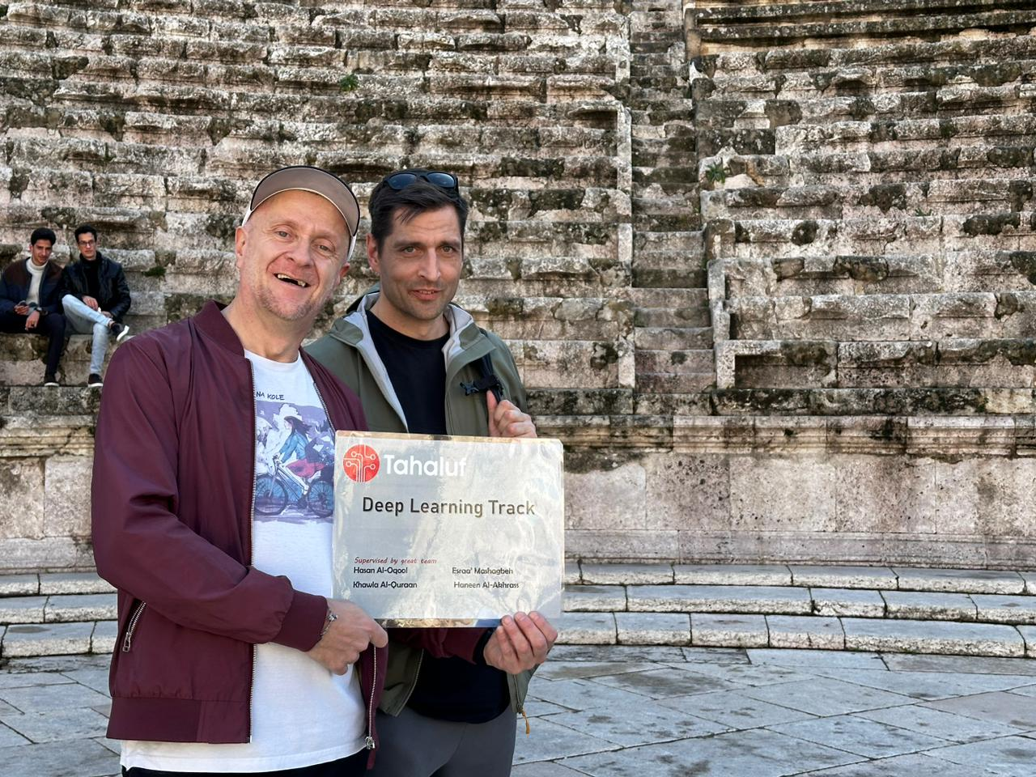
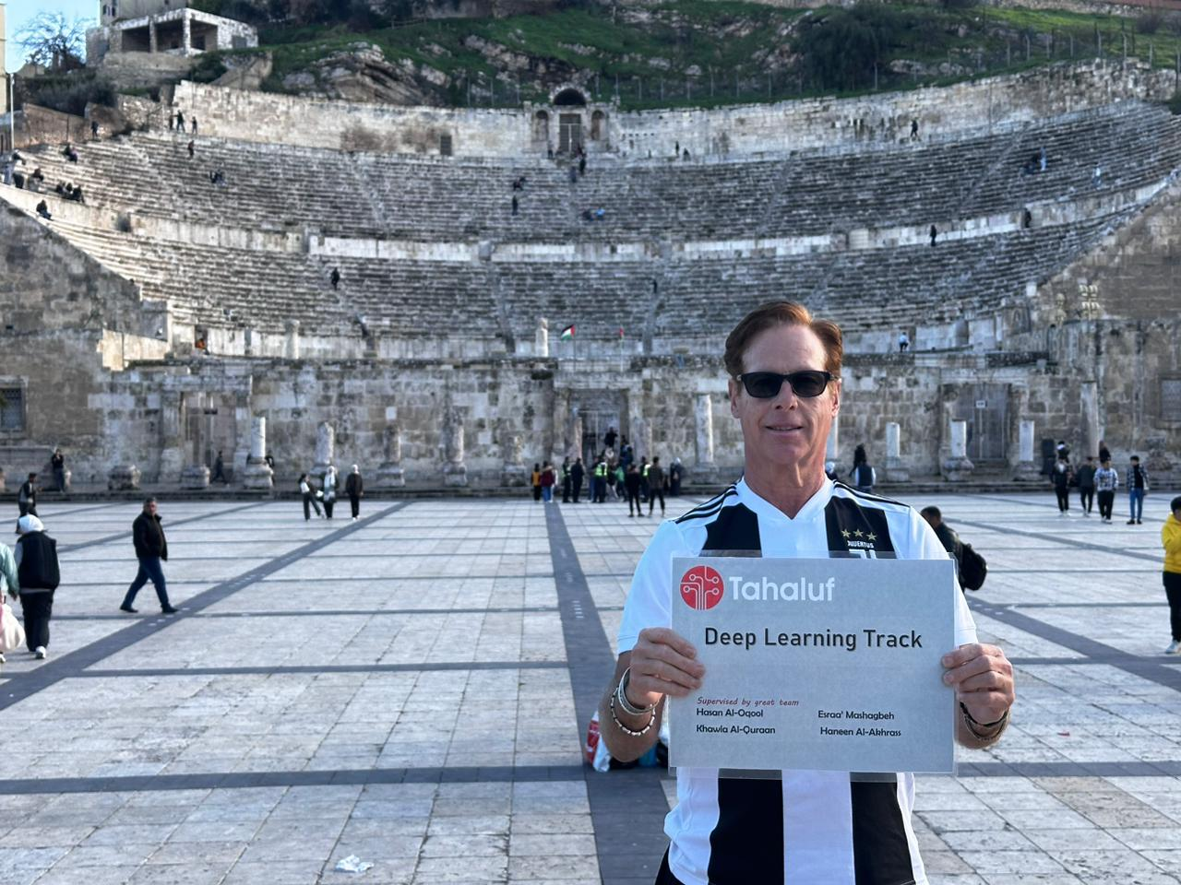
Our
Exclusive
Collection

Slide 30
Our
Exclusive
Collection

Slide 31
Our
Exclusive
Collection

Slide 32
Our Team
Sora
Abdullah
Mohammad
Aqeel

Slide 33
Resources
Data Collection
https://www.istockphoto.com/
https://unsplash.com/
https://www.shutterstock.com/
https://www.pexels.com/
https://www.visitpetra.jo/
https://stock.adobe.com/
https://www.dreamstime.com/

Slide 34


Thanks
Do you have any questions? No.
admin@bahith.com
+962 770 421 88
bahith.com

